Slide 1
Subject: Auditing Topic: Audit Evidence Course: B.com Part-I (H) Dr. Ishtiaque Ahmed Dept. of Commerce Purnea College, Purnia Email:driahmedar@gmail.com
Dept of Commerce Purnea College Purnia

Slide 2
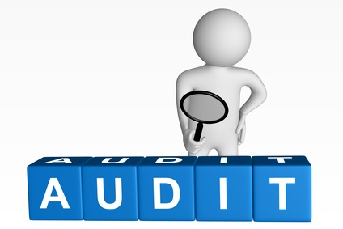
Auditing
Auditing is concerned with verification of accounting data determining the accuracy and reliability of accounting statements and reports.
R.K.Mautz

Slide 3
Auditing Evidence
The information obtained by the auditor in arriving at the conclusions on which the audit opinion is based . The auditor should obtained sufficient and appropriate audit evidence to be able to draw reasonable conclusions on which to base the audit opinion.
Appropriateness of audit evidence depends upon :
Relevancy of data
Reliability of data

Slide 4
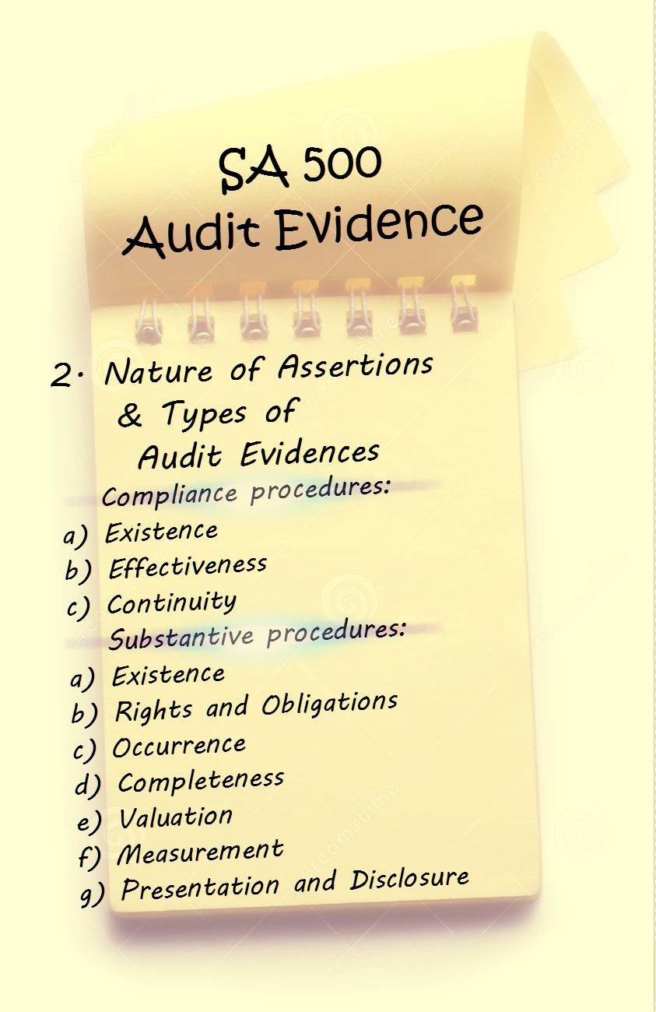
Evidence for Assertions The auditor should obtained sufficient and appropriate evidence by following procedure .
Compliance procedures: Some of the assertions made in the financial statements can be examined on the basis of audit evidence obtained from compliance procedures . These assertions relate to:
Existence of internal control system.
Effectiveness of internal control system.
Continuity of the control system.
Substantive procedures : Some of the assertions made in the financial statements are examined on the basis of audit evidence obtained from substantive procedures . These are :
Existence of an asset or liability on the given date.
Rights and obligations related to an asset.
Occurrence of an event during the relevant period.

Slide 5
Formation of Opinion The process of opinion formation involves following 5 steps:
Identification of the assertions :The auditor has to satisfy himself and report whether or not the profit and loss account and balance sheet reveals the true and fair view of the financial position of the concern and to check the books of account have been maintained and prepared according to the provision of law or not.
Evaluation of the assertions : In this step the auditor has to see whether these are material assertions or immaterial assertions. The immaterial assertions should be evaluated keeping in view their relative significance the materiality and significance of an assertion will depend on its nature ,size in terms of amount, impact on the final position and on the overall assertions made through the financial statements.
Collection of evidence : Auditor should collect the necessary evidence which supports the assertions . These evidences should be adequate ,appropriate and reliable . Auditor should use proper audit techniques.
An auditor’s judgment will be influence by following factors such as:
1. Materiality of the items;
2. Past experience;
3. Type of information.

Slide 6
Auditor should check the reliability of the evidence placed before him .The factors that will go into determining the reliability of the evidence are :
Whether the source is internal or external and is it reliable ?
Is it documentary or visual ?
Are evidences from different sources consistent if there is inconsistency can it be resolved?
Evaluation of evidence : In evaluation , it is to be seen whether the evidence is sufficient, appropriate or not? This will require an examination of its quantity , relevancy , reliability and validity . The evidence should be sufficient and valid to satisfy the auditor about the events that took place in the past when he was not present. It is for the auditor to evaluate the evidence on these lines before forming any opinion.
Formation of opinion or judgement : The auditor is to form his opinion in the light of the available evidence . The sufficiency ,reliability , validity and appropriateness of the evidence should be the key to formation of opinion or judgement.

Slide 7
Types of Auditing Evidence
Accounting System: The basic evidence regarding financial statements will emerge from the accounting system which must be reliable . The auditor may look into the procedure to be followed by each employee .Acceptance of the evidence originating from the accounting system will also depend upon the reliability of internal control system. It is the duty of the auditor to look for evidence beyond the accounting system.
Example : Accounting records and support for transaction and journal entries.
Physical Evidence : In case of tangible assets like plant and machinery ,stock ,furniture etc physical evidence is the best evidence which proves the actual existence of the assets however it will not prove the correct valuation shown in the balance sheet . It is possible to physically verify cash in hand however the cash at bank can be evidenced by documents only .Sometimes physical evidence may not be sought Example: Physical evidence may not be available at the place of audit as it is located at distant place .
Documentary Evidence: Most of the evidence is in the form of documents even if the physical evidence is available the documentary evidence has its own importance .
Example : There may be the physical evidence of building in possession of the business ,but the ownership can be proved only on the basis of documents .

Slide 8
Journals and Ledgers : Journals are books of original entry and ledgers are books of final entry. The sources of ledger are the basis of financial statements. Entries in the journal should be evidenced by source documents . Thereafter only the posting into the ledger determination of the balances and preparation of financial statements be checked.
Ratios :At times ratios belonging to the different periods of the same organisations or comparison of ratios of different concerns may suggest the going on in an organisation.
Oral Evidence : Oral discussion with officers may bring out certain facts . Consistency in the statement of different officials will evidence the reliability of happening inconsistencies should suggest the opposite .
Subsequent events: Events subsequent to the date of financial statements can also be used as evidence . It can reveal window dressing at the time of finalisation of the accounts .Example :Entries regarding huge deposits before the balance sheet and the subsequent withdrawals in the next year put a question mark on the reliability of performance revealed by the financial statement of the bank .

Slide 9
Audit Techniques The methods or processes through which the auditor collects the evidence can be called audit techniques.
Vouching: Inspecting payment vouchers.
Example : suppliers invoice.
Reconciliations :The auditor Reconciles the difference in figures arrived at the use of different methods by finding the causes of difference.
Example : Entry regarding rent received may differ from the figure of monthly rent multiplied by twelve.
Physical Examination : The physical existence of the tangible assets appearing the balance sheet is verified through physical examination it involves evaluation of quality of assets.
Confirmation : The auditor independently communicates with outside parties ,interviews with the organisation to ascertain the validity and correctness of the transactions .
Example : Written statement may be obtained from debtors.

Slide 10
Analysis : It is a process of segregating important facts to study their relationship .
Example : Comparison of ratios over a period or with organisations can reveal whether certain items bear reasonable and logical relationship .
Scanning : It is a wide sweeping hurried search for relevant information .An experienced auditor can identify the entries which would require his attention.
Inquiry : This method may be used to gather in depth information about certain things.
Example : Effectiveness of the internal control system.
Footing : In this technique to check the totals ,columns of different accounting figures are added.
Scouring : This means critical study of the characteristic of the data.

